Slide 1

FRONT END LOADER SAFETY PROGRAM
Rodolfo Ochoa, Hy-Tech Mushroom Compost
Ben Sheets, Phillips Mushroom Farms

Slide 2
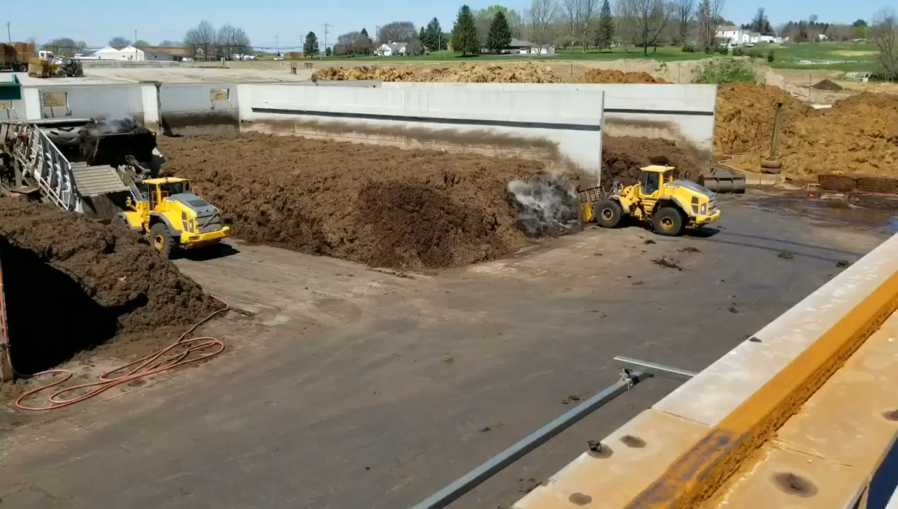

Slide 3
AMI’s Front End Loader Safety Subcommittee
Members of the MESH Committee identified a need for a standardized set of front end loader safety training resources in the fall of 2018
The Front End Loader Safety (FELS) Subcommittee was created consisting of members from farms and compost wharfs alike
The scope of the subcommittee’s membership demonstrates the variety of ways in which members of the mushroom farm community are using front end loaders

Slide 4
AMI’s Front End Loader Safety Subcommittee
      Ben Sheets, Phillips Mushroom Farms
      Rodolfo Ochoa, Hy-Tech Mushroom Compost
      Sam Wilson, Needham’s Mushroom Farm
      Amanda Alonso, Laurel Valley Farms
      Scott Wood, Greenwood Mushrooms
      Richard Rush, Kaolin Mushroom Farms
      Jim Harrity, OSHA

Slide 5
AMI’s Front End Loader Safety Subcommittee
FELS Subcommittee has been meeting monthly just before the regularly scheduled MESH Committee meetings
The goals of subcommittee meetings are to:
  Review existing materials pertaining to front end loader safety and repackage them so that they are specific to the mushroom farm community
  Produce a standardized set of best practices and set an industry standard
  Network and share safety ideas and tools

Slide 6
Subcommittee
Stakeholders
AMI staff and subcommittee members are collaborating to build a toolkit of training resources for front end loader safety best practices
Toolkit will be available for AMI members
Designed for mushroom farms and mushroom compost wharf employees
Stakeholders include: farm/wharf employee trainers and HR representatives; loader operators; farm/wharf pedestrians; and everyone around them!

Slide 7

Current Products
of Toolkit
General training PowerPoint designed specifically for loader operators
Useful for introducing new loader operators to loader safety
Also good for periodically reinforcing safety with seasoned loader operators

Slide 8
Current Products
of Toolkit
Key components of the PowerPoint include information about front end loader safety pertaining to:
    Preparation and inspection before boarding the loader
    Inspection after boarding
    General operating procedures
    Procedures specific to operating the bucket
    Common misperceptions to avoid
    Weather considerations
    Pedestrian safety

Slide 9
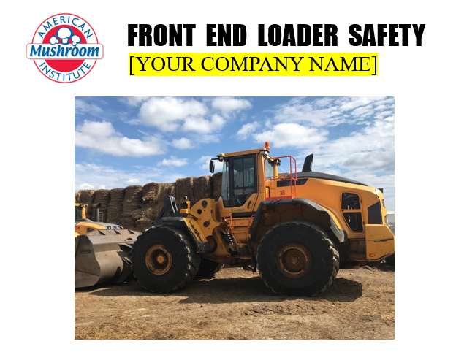
Current Products
of Toolkit
PowerPoint is customizable; trainers are prompted to add photos of site specific hazards (such as slopes or other uneven terrain)
Trainers are encouraged to add information about company policies – or anything else!
Available for download on AMI’s website in English

Slide 10
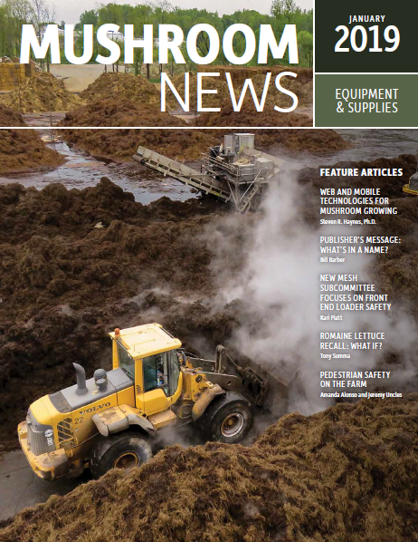
Current Products
of Toolkit
Mushroom News article from January 2019’s issue titled “Pedestrian Safety on the Farm,” written by Amanda Alonso and Jeremy Uncles, Laurel Valley Farms
Focuses on safety principles such as designated pedestrian zones, minimizing pedestrian traffic in loader operation areas and communication through hand signals

Slide 11
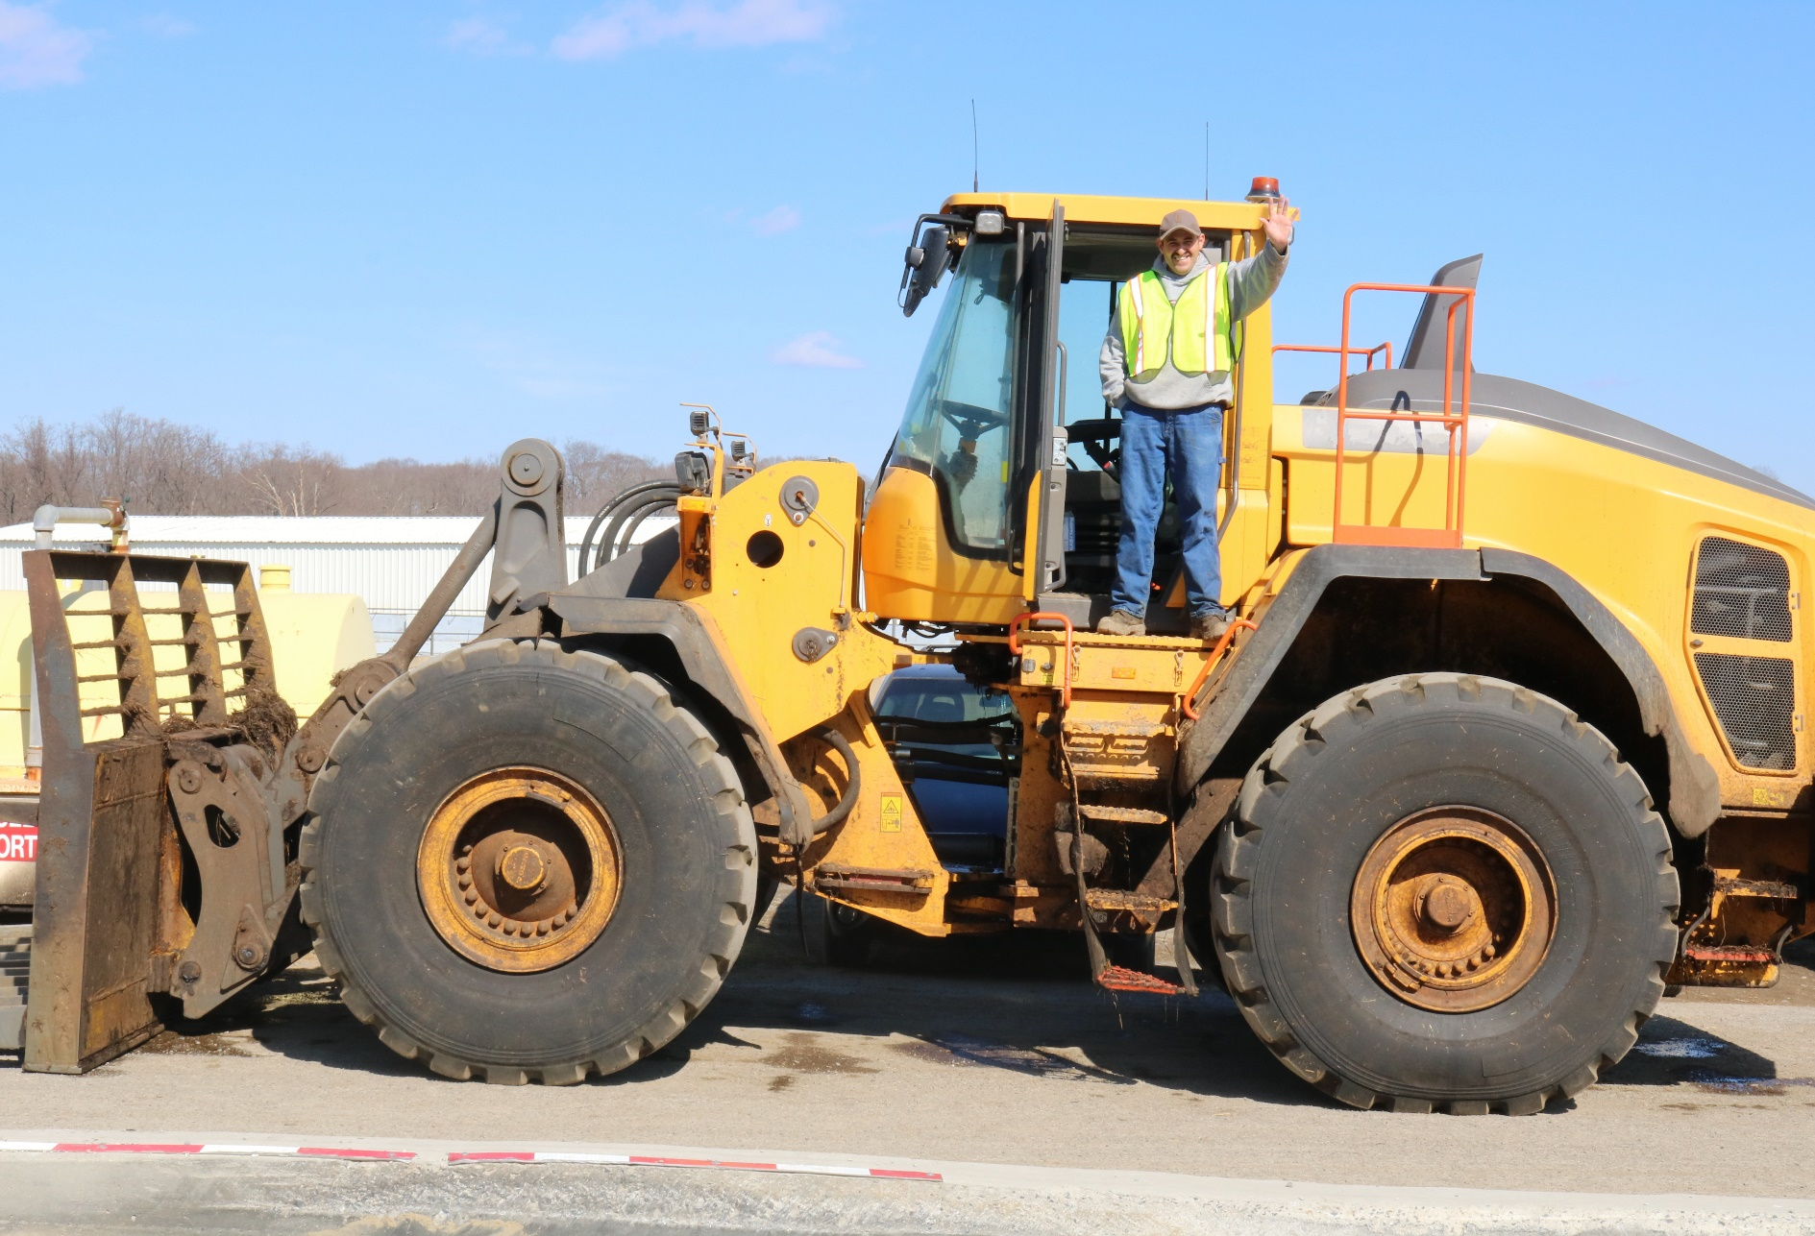
Resources in Spanish
As the subcommittee moves forward, resources will be available in English and Spanish in order to make it more accessible and useful for all mushroom farm community employees
The PowerPoint may eventually include a voiceover option in English and Spanish

Slide 12
Next Steps
Continue creating products to complete a tool kit for farms and compost wharfs
Supplemental documents will focus on areas like seatbelt safety, lockout tagout (LOTO) for loaders, blind spot safety and pinch points
May come in the form of additional PowerPoints, articles and handouts, or videos
Subcommittee will continue to produce information relevant to both farms and wharfs in order to represent companies across the mushroom farm community

Slide 13
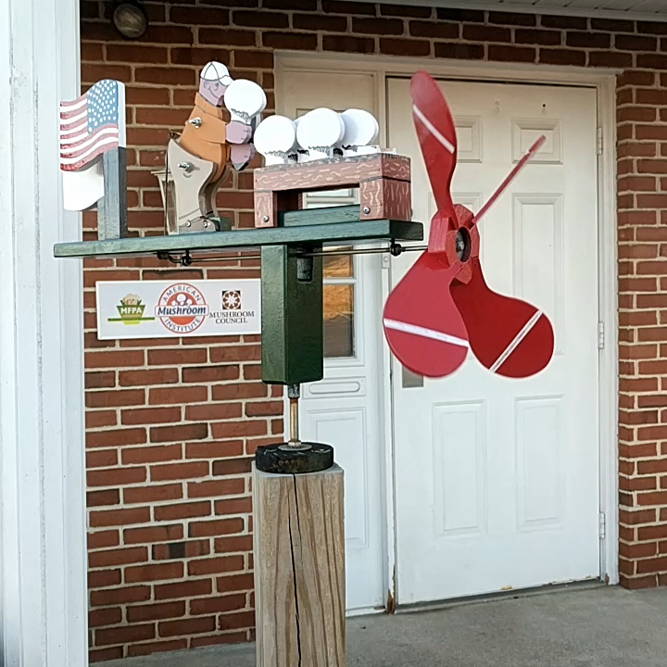
Subcommittee
Membership
AMI would like to expand the membership of the subcommittee; please contact Kari if you are interested in joining and spread the word
Meetings are held at the AMI office in Avondale and via teleconference

Slide 14
Questions?

